Slide 1


Cloud Computing
K.K.Wagh Institute of Engineering Education & Research
Nashik
Notes:
NOTE:
To change the image on this slide, select the picture and delete it. Then click the Pictures icon in the placeholder to insert your own image.
1

Slide 2
Data Storage and Cloud Computing (Unit 2)

Slide 3
Outline
Data Storage: Introduction to Enterprise Data Storage
Direct Attached Storage
Storage Area Network
Network Attached Storage
Data Storage Management
File System
Cloud Data Stores
Using Grids for Data Storage
Cloud Storage: Data Management, Provisioning Cloud storage
Data Intensive Technologies for Cloud Computing
Cloud file system (gfs and hdfs)
Distributed Data Storage

Slide 4
Data Storage: Introduction to Enterprise Data Storage
Definition:
Systems and technologies for storing, managing, and retrieving data in a business environment.
It encompasses a range of solutions designed to handle large volumes of data efficiently and securely.
Importance:
Essential for managing large volumes of data efficiently and securely.

Slide 5
Types of Data Storage Solutions
On-Premises Storage: Traditional storage solutions located within the organization’s physical premises. This includes:
Direct Attached Storage (DAS): Storage devices directly connected to a server.
Network Attached Storage (NAS): Dedicated file storage that allows multiple users to access data over a network.
Storage Area Network (SAN): A high-speed network that provides access to consolidated block-level storage.

Slide 6
Types of Data Storage Solutions
Cloud Storage: A model that allows data to be stored on remote servers accessed via the internet.
Key characteristics include:
Scalability: Easily scale storage capacity based on demand.
Cost-Effectiveness: Pay-as-you-go pricing models reduce upfront costs.
Accessibility: Data can be accessed from anywhere with an internet connection.

Slide 7
Types of Data Storage Solutions
Hybrid Storage Solutions: Combines on-premises and cloud storage, allowing organizations to leverage the benefits of both environments.

Slide 8
Key Considerations for Enterprise Data Storage
Data Security:
Encryption, access controls, compliance with regulations (e.g., GDPR, HIPAA).
Data Backup and Recovery:
Regular backups and disaster recovery plans.
Performance and Latency:
Fast access to data for real-time processing.
Data Management:
Organizing and managing data for easy retrieval.

Slide 9
Emerging Trends in Data Storage
Cloud Computing:
Shift towards cloud-based storage solutions for flexibility and reduced costs.
Big Data Technologies:
Handling vast amounts of unstructured data (e.g., Hadoop, NoSQL).
Artificial Intelligence and Machine Learning:
Enhancing data management and automating processes.

Slide 10
Best Practices for Implementing Enterprise Data Storage
Assess Business Needs:
Understand specific data storage requirements.
Choose the Right Solution:
Implement Security Measures:
Prioritize data security with encryption and audits.
Regularly Review and Optimize:
Monitor performance and costs; optimize configurations.
Evaluate on-premises, cloud, and hybrid options.

Slide 11
Direct Attached Storage (DAS)
Definition of Direct Attached Storage (DAS):
Direct Attached Storage (DAS) refers to storage devices that are directly connected to a computer or server without a network in between.
Examples:
Hard drives, solid-state drives, and external storage devices that connect via USB, SATA, or SCSI interfaces.

Slide 12
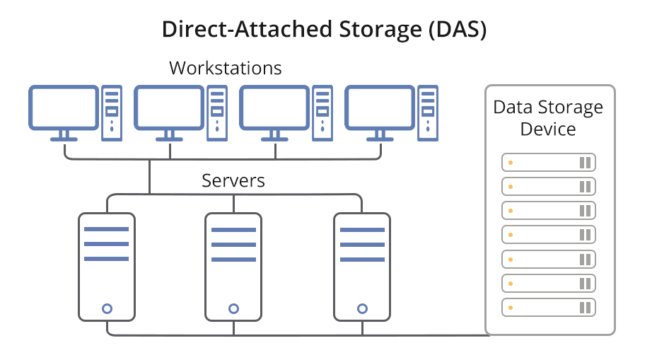
Direct Attached Storage (DAS)

Slide 13
Direct Attached Storage (DAS)
Characteristics of DAS:
Connection: Directly attached to a single server or workstation.
Performance: Typically offers high-speed data access due to the direct connection.
Simplicity: Easy to set up and manage, as it does not require complex networking configurations.
Cost-Effectiveness: Generally less expensive than networked storage solutions, making it a budget-friendly option for small to medium-sized businesses.

Slide 14
Direct Attached Storage (DAS)
Types of DAS:
Internal Storage: Hard drives or SSDs installed within the computer or server.
External Storage: Standalone devices connected via USB, Thunderbolt, or other interfaces, allowing for easy portability and additional storage capacity.

Slide 15
Direct Attached Storage (DAS)
Advantages of DAS:
High Performance: Low latency and high throughput due to direct connections.
Ease of Use: Simple installation and management without the need for network configuration.
Cost-Effective: Lower initial investment compared to networked storage solutions.
Data Security: Data is stored locally, reducing exposure to network vulnerabilities.

Slide 16
Direct Attached Storage (DAS)
Disadvantages of DAS:
Limited Scalability: Adding more storage requires physical installation of additional devices, which can be cumbersome.
Single Point of Failure: If the attached device fails, data may be lost unless backed up elsewhere.
Limited Accessibility: Data is only accessible from the connected server or workstation, making it less suitable for collaborative environments.

Slide 17
Direct Attached Storage (DAS)
Use Cases for DAS:
Personal Computing: Ideal for individual users needing additional storage for files, media, and applications.
Small Businesses: Suitable for businesses with limited data storage needs that do not require complex networking.
Backup Solutions: Often used for local backups due to its simplicity and cost-effectiveness.

Slide 18
Storage Area Network (SAN)
Definition of Storage Area Network (SAN):
A Storage Area Network (SAN) is a dedicated network that provides access to consolidated block-level storage, allowing multiple servers to access shared storage resources.
SANs are designed to enhance storage devices' performance and availability, making them ideal for enterprise environments.

Slide 19
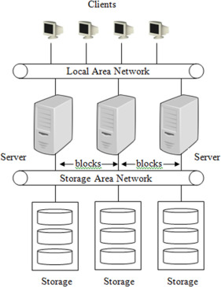
Storage Area Network (SAN)

Slide 20
Storage Area Network (SAN)
Characteristics of SAN:
High-Speed Connectivity: Utilizes high-speed network technologies (e.g., Fibre Channel, iSCSI) to connect servers and storage devices, ensuring low latency and high throughput.
Block-Level Storage: Provides storage at the block level, allowing for more efficient data management and performance compared to file-level storage.
Scalability: Easily scalable to accommodate growing storage needs by adding more storage devices or servers without significant disruption.

Slide 21
Storage Area Network (SAN)
Components of a SAN:
Storage Devices: Disk arrays or tape libraries that store data.
Switches: Network switches that connect servers to storage devices, facilitating data transfer.
Host Bus Adapters (HBAs): Interface cards installed in servers to connect to the SAN.
Management Software: Tools for monitoring, managing, and configuring the SAN environment.

Slide 22
Storage Area Network (SAN)
Advantages of SAN:
Performance: High-speed data transfer rates and low latency improve application performance, especially for data-intensive applications.
Centralized Storage Management: Simplifies storage management by consolidating storage resources, making it easier to allocate and manage storage.
Flexibility: Allows for the use of various storage technologies and configurations, adapting to different business needs.

Slide 23
Storage Area Network (SAN)
Disadvantages of SAN:
Complexity: SANs can be complex to design, implement, and manage, requiring specialized knowledge and skills.
Cost: Higher initial investment compared to simpler storage solutions like Direct Attached Storage (DAS) or Network Attached Storage (NAS).
Maintenance: Ongoing maintenance and management can require dedicated IT resources.

Slide 24
Storage Area Network (SAN)
Use Cases for SAN:
Enterprise Applications: Ideal for environments with high transaction volumes, such as databases and enterprise resource planning (ERP) systems.
Virtualization: Supports virtualized environments by providing shared storage for multiple virtual machines, improving resource utilization.
Data Backup and Recovery: Facilitates efficient backup and recovery processes through centralized storage management and data protection features.

Slide 25
Network Attached Storage
Definition of Network Attached Storage (NAS):
Network Attached Storage (NAS) is a dedicated file storage device that provides data access to a network of clients. It allows multiple users and devices to retrieve and store data from a centralized location over a network.
NAS operates on standard network protocols, making it accessible to various operating systems and devices.

Slide 26
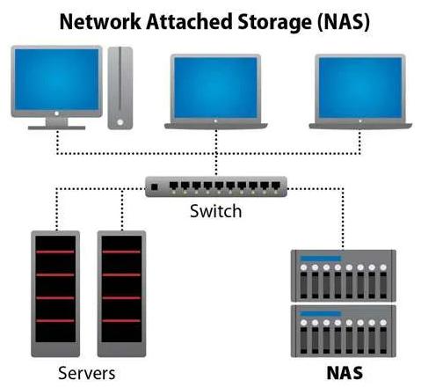
Network Attached Storage

Slide 27
Network Attached Storage
Characteristics of NAS:
File-Level Storage: Unlike block-level storage (e.g., SAN), NAS provides file-level access, allowing users to store and retrieve files using standard file-sharing protocols (e.g., NFS, SMB/CIFS).
Network Connectivity: NAS devices connect to a local area network (LAN) via Ethernet, enabling easy access from multiple devices.
User -Friendly Interface: Many NAS systems come with web-based interfaces for easy configuration and management.

Slide 28
Network Attached Storage
Components of NAS:
Storage Drives: Typically consists of multiple hard drives or SSDs configured in RAID for redundancy and performance.
Network Interface: Ethernet ports for connecting to the network.
Operating System: A specialized OS that manages storage, file sharing, and user access.
Management Software: Tools for monitoring performance, managing users, and configuring settings.

Slide 29
Network Attached Storage
Advantages of NAS:
Centralized Storage: Provides a single location for data storage, making it easier to manage and back up data.
Scalability: Easily expandable by adding more drives or additional NAS units to the network.
Accessibility: Allows access to files from any device on the network, including computers, tablets, and smartphones.
Cost-Effective: Generally more affordable than SAN solutions, making it suitable for small to medium-sized businesses and home users.

Slide 30
Network Attached Storage
Disadvantages of NAS:
Performance Limitations: May not provide the same performance as SANs for high-demand applications due to file-level access.
Network Dependency: Performance is dependent on network speed and reliability; a slow network can lead to bottlenecks.
Limited Advanced Features: While NAS devices offer basic data protection features, they may lack the advanced capabilities found in SANs, such as block-level storage and extensive redundancy options.

Slide 31
Network Attached Storage
Use Cases for NAS:
File Sharing: Ideal for environments where multiple users need to access and share files, such as offices and collaborative workspaces.
Backup Solutions: Commonly used for centralized backups of data from multiple devices, providing a simple and efficient backup solution.
Media Streaming: Suitable for storing and streaming media files (e.g., videos, music) to various devices within a home or office network.
Virtualization: Can be used in virtualized environments for storing virtual machine images and data.

Slide 32
Data Storage Management
Definition of Data Storage Management:
Data Storage Management refers to the processes and technologies used to manage data storage resources effectively.
It encompasses the organization, storage, retrieval, and protection of data across various storage systems.

Slide 33
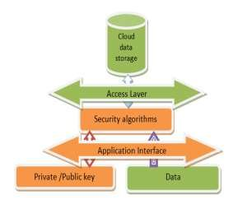
Data Storage Management

Slide 34
Types of Data Storage Management
File-Based Storage Management:
Definition: Involves managing data stored in files, typically organized in a hierarchical structure (directories and subdirectories).
Characteristics:
Simple organization of data.
Commonly used in personal computing and small business environments.
Examples: Network Attached Storage (NAS) systems that allow file sharing across a network.

Slide 35
Types of Data Storage Management
Block-Based Storage Management:
Definition: Manages data in fixed-size blocks, allowing for high-performance access and manipulation.
Characteristics:
Provides low-latency access to data.
Suitable for applications requiring high I/O operations, such as databases and virtual machines.
Examples: Storage Area Networks (SAN) that provide block-level storage to multiple servers.

Slide 36
Types of Data Storage Management
Object-Based Storage Management:
Definition: Manages data as objects, which include the data itself, metadata, and a unique identifier.
Characteristics:
Highly scalable and suitable for unstructured data.
Facilitates easy access and retrieval of data through APIs.
Examples: Cloud storage solutions like Amazon S3 and Google Cloud Storage.

Slide 37
Types of Data Storage Management
Cloud Storage Management:
Definition: Involves managing data stored in cloud environments, where data is stored on remote servers accessed via the internet.
Characteristics:
Offers scalability, flexibility, and cost-effectiveness.
Provides features like automatic backups, data redundancy, and disaster recovery.
Examples: Services like Microsoft Azure, Google Cloud Platform, and Dropbox.

Slide 38
Types of Data Storage Management
Hybrid Storage Management:
Definition: Combines on-premises storage solutions with cloud storage, allowing organizations to leverage the benefits of both environments.
Characteristics:
Provides flexibility in data management and storage allocation.
Enables organizations to optimize costs and performance based on data access patterns.
Examples: Using local storage for frequently accessed data while archiving less critical data in the cloud.

Slide 39
Data Storage Management
Importance of Data Storage Management:
Data Accessibility: Ensures that data is readily available to users and applications when needed.
Data Security: Protects sensitive information from unauthorized access and breaches.
Cost Efficiency: Optimizes storage resources to reduce costs associated with data storage and management.
Compliance: Helps organizations adhere to regulatory requirements regarding data retention and protection.

Slide 40
Data Storage Management
Key Components of Data Storage Management:
Data Classification: Organizing data into categories based on its importance, sensitivity, and usage patterns. This helps in applying appropriate storage policies and access controls.
Data Backup and Recovery: Implementing strategies to regularly back up data and ensure it can be restored in case of loss or corruption. This includes full, incremental, and differential backups.

Slide 41
Data Storage Management
Key Components of Data Storage Management:
Data Archiving: Moving infrequently accessed data to lower-cost storage solutions to free up primary storage resources while ensuring long-term retention.
Storage Tiering: Utilizing different types of storage (e.g., SSDs, HDDs, cloud storage) based on performance and cost requirements. Frequently accessed data can be stored on high-performance storage, while less critical data can be moved to slower, more cost-effective options.

Slide 42
Data Storage Management
Data Storage Management Strategies:
Capacity Planning: Analyzing current and future storage needs to ensure adequate resources are available. This involves forecasting data growth and planning for scalability.
Performance Monitoring: Continuously monitoring storage performance to identify bottlenecks and optimize resource allocation. Tools and software can help track metrics such as I/O operations, latency, and throughput.

Slide 43
Data Storage Management
Data Storage Management Strategies:
Data Deduplication: Reducing storage requirements by eliminating duplicate copies of data. This is particularly useful in backup and archiving processes.
Data Encryption: Protecting data at rest and in transit through encryption techniques to safeguard sensitive information from unauthorized access.

Slide 44
File System
Definition of File System:
A file system is a method and data structure that an operating system uses to manage files on a storage device.
It defines how data is stored, organized, accessed, and retrieved on storage media such as hard drives, SSDs, and removable storage devices.

Slide 45
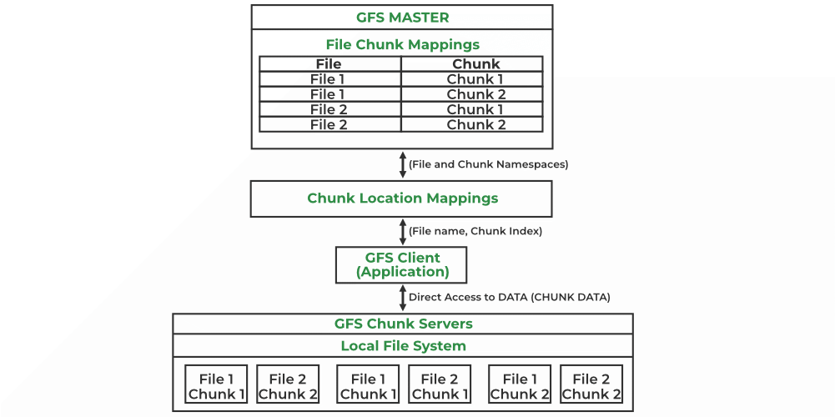
File System

Slide 46
File System
Purpose of File Systems:
Data Organization: Provides a structured way to store and organize files and directories, making it easier for users and applications to access data.
Data Management: Facilitates the management of file attributes, permissions, and metadata, ensuring efficient data handling.
Data Access: Enables users and applications to read, write, and manipulate files through a consistent interface.

Slide 47
File System
Key Components of a File System:
Files: The basic unit of storage, which contains data and is identified by a unique name.
Directories: Containers that hold files and other directories, allowing for hierarchical organization of data.

Slide 48
File System
Key Components of a File System:
Metadata: Information about files, such as file name, size, type, creation date, modification date, and permissions.
File Allocation Table (FAT): A data structure that keeps track of the allocation of disk space for files, indicating which clusters are used and which are free.

Slide 49
Types of File Systems
Traditional File Systems:
FAT (File Allocation Table): An older file system used in DOS and Windows, known for its simplicity and compatibility.
NTFS (New Technology File System): A more advanced file system used in modern Windows operating systems, supporting large files, security features, and journaling.
HFS+ (Hierarchical File System Plus): Used by macOS, supporting features like journaling and metadata.

Slide 50
Types of File Systems
Unix/Linux File Systems:
ext3/ext4: Common file systems used in Linux, with ext4 being the latest version, offering improved performance and features.
XFS: A high-performance file system designed for scalability and large data sets.

Slide 51
Types of File Systems
Distributed File Systems:
NFS (Network File System): Allows file sharing over a network, enabling remote access to files.
CIFS (Common Internet File System): A protocol used for sharing files and printers in Windows networks.

Slide 52
File System
File System Operations:
File Creation: The process of creating a new file and allocating space for it on the storage device.
File Reading/Writing: Accessing the contents of a file for reading or modifying data.

Slide 53
File System
File System Operations:
File Deletion: Removing a file from the file system, which may involve freeing up allocated space.
File Renaming: Changing the name of an existing file while maintaining its contents and attributes.

Slide 54
File System
File System Features:
Access Control: Mechanisms to define who can access or modify files, typically through permissions and user roles.
Journaling: A feature that keeps a log of changes to the file system, helping to recover data in case of a crash or power failure.

Slide 55
File System
File System Features:
Compression: Reducing the size of files to save storage space, often supported by modern file systems.
Encryption: Protecting files by encoding their contents, ensuring that only authorized users can access the data.

Slide 56
File System
File System Features:
Compression: Reducing the size of files to save storage space, often supported by modern file systems.
Encryption: Protecting files by encoding their contents, ensuring that only authorized users can access the data.

Slide 57
Cloud Data Stores
Definition of Cloud Data Stores:
Cloud data stores are storage solutions that allow data to be stored, managed, and accessed over the internet using cloud computing technologies.
They provide scalable, flexible, and cost-effective options for data storage and management.

Slide 58
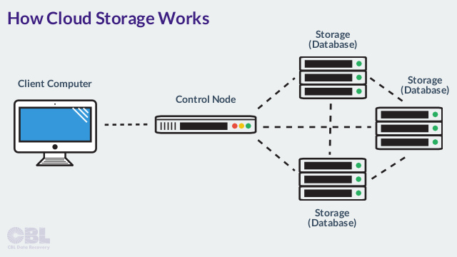
Cloud Data Stores

Slide 59
Types of Cloud Data Stores
Object Storage:
Definition: Stores data as objects, which include the data itself, metadata, and a unique identifier.
Characteristics:
Highly scalable and suitable for unstructured data (e.g., images, videos).
Accessed via APIs, making it easy to integrate with applications.
Examples: Amazon S3, Google Cloud Storage, Microsoft Azure Blob Storage.

Slide 60
Types of Cloud Data Stores
Block Storage:
Definition: Provides raw storage volumes that can be attached to virtual machines (VMs) and accessed as block devices.
Characteristics:
Offers low-latency access and high performance, suitable for databases and applications requiring fast I/O operations.
Allows for the creation of file systems on top of the block storage.
Examples: Amazon Elastic Block Store (EBS), Google Persistent Disk, Azure Managed Disks.

Slide 61
Types of Cloud Data Stores
File Storage:
Definition: Provides a file system interface for storing and accessing files over the cloud.
Characteristics:
Supports file sharing and collaboration among multiple users and applications.
Typically uses standard protocols like NFS or SMB for access.
Examples: Amazon Elastic File System (EFS), Google Filestore, Azure Files.

Slide 62
Using Grids for Data Storage
Introduction to Grid Computing:
Definition: Grid computing is a distributed computing model that connects multiple computers (or nodes) to work collaboratively on a common task, sharing resources such as processing power and storage.
Purpose: It aims to provide high-performance computing capabilities by pooling resources from various locations, enabling efficient data storage and processing.

Slide 63
Using Grids for Data Storage
Concept of Grid-Based Data Storage:
Grid Data Storage: Involves using a grid computing architecture to manage and store data across multiple distributed nodes. This approach allows for efficient data management, high availability, and redundancy.
Architecture: Typically consists of a network of interconnected nodes (servers) that collaborate to store and process data. Each node can contribute storage capacity and processing power.

Slide 64
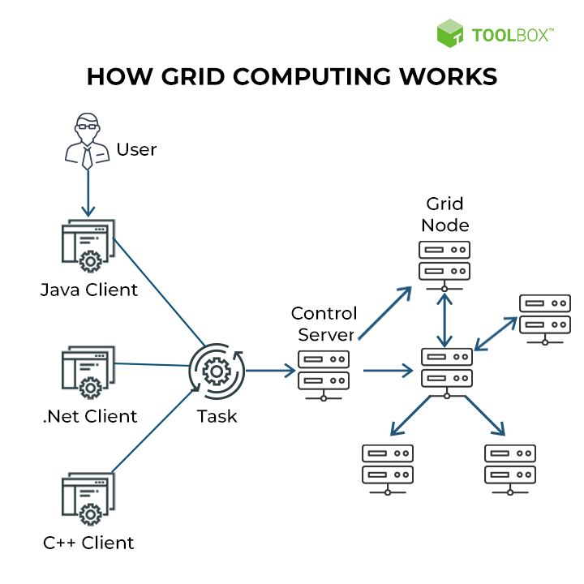
Working of Grid Computing

Slide 65
Working of Grid Computing
A typical grid computing network consists of three machine types:
Control node/server: A control node is a server or a group of servers that administers the entire network and maintains the record for resources in a network pool.
Provider/grid node: A provider or grid node is a computer that contributes its resources to the network resource pool.
User: A user refers to the computer that uses the resources on the network to complete the task.

Slide 66
Working of Grid Computing
In grid computing, each computing task is broken into small fragments and distributed across computing nodes for efficient execution.
Let’s consider this equation:
X = (4 x 7) + (3 x 9) + (2 x 5)
Typically, on a desktop computer, the steps needed here to calculate the value of X may look like this:
Step 1: X = 28 + (3 x 9) + (2 x 5)
Step 2: X = 28 + 27 + (2 x 5)
Step 3: X = 28 + 27 + 10
Step 4: X = 65

Slide 67
Working of Grid Computing
However, in a grid computing setup, the steps are different as three processors or computers calculate different pieces of the equation separately and combine them later.
The steps look like this:
Step 1: X = 28 + 27 + 10
Step 2: X = 65

Slide 68
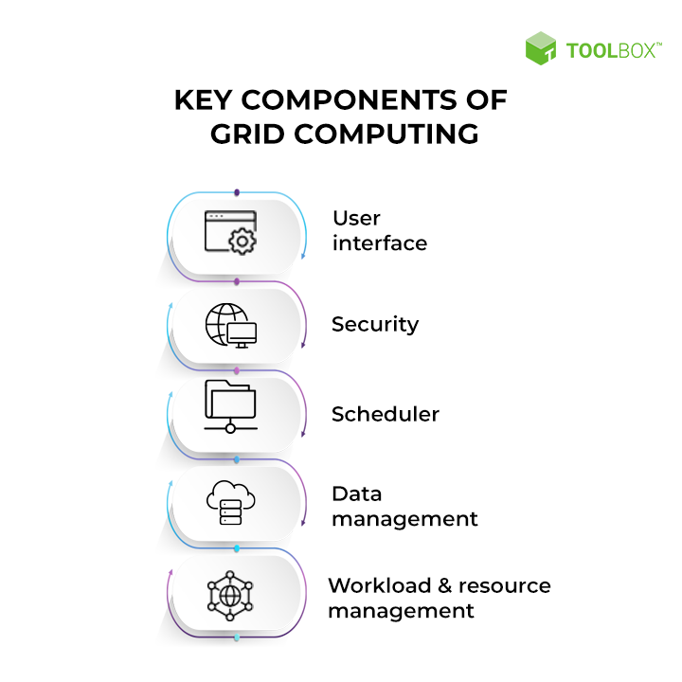
Key Components of Grid Computing

Slide 69
Key Components of Grid Computing
User Interface: Allows users to interact with the grid.
Security: Ensures data protection and secure access.
Scheduler: Manages and assigns tasks to resources.
Data Management: Handles storage, retrieval, and processing of data.
Workload and Resource Management: Optimizes resource utilization and manages the workload.

Slide 70
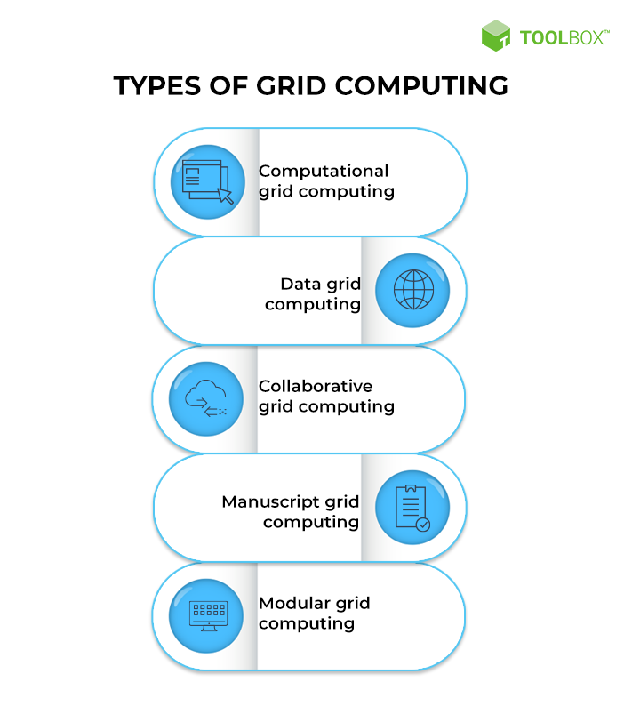
Types of Grid Computing

Slide 71
Types of Grid Computing
Computational Grid Computing: Uses interconnected computers to solve complex problems.
Data Grid Computing: Focuses on sharing and managing vast datasets across a network.
Collaborative Grid Computing: Enables collaboration among users to solve common problems.

Slide 72
Types of Grid Computing
Manuscript Grid Computing: Deals with the digitization and analysis of handwritten documents.
Modular Grid Computing: Utilizes modular components to build flexible and scalable computing systems.

Slide 73
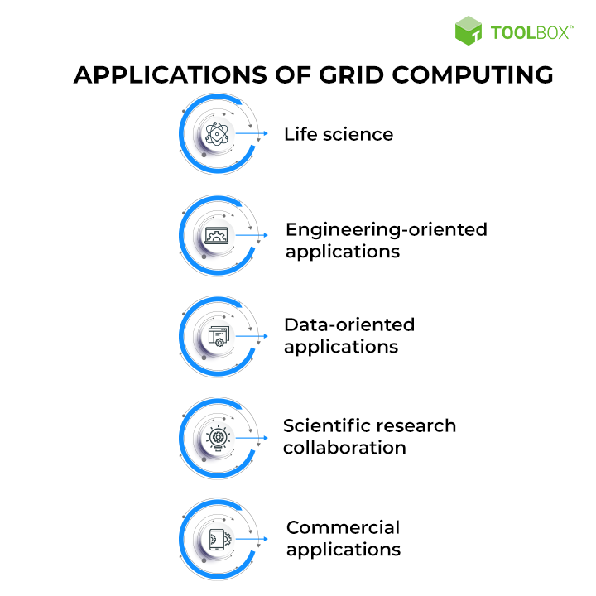
Applications of Grid Computing

Slide 74
Applications of Grid Computing
Life science: Grid computing is used to analyze large datasets of genetic information.
Engineering-oriented applications: Grid computing is used to simulate complex engineering problems.
Data-oriented applications: Grid computing is used to process and analyze large datasets.

Slide 75
Applications of Grid Computing
Scientific research collaboration: Grid computing allows scientists to share data and resources to work together on large research projects.
Commercial applications: Grid computing is being used by businesses to improve efficiency and performance.

Slide 76
Cloud Storage: Data Management
Cloud Storage Models
File Storage:
Hierarchical storage (directories and files).
Suitable for shared file systems.
Examples: NAS (Network Attached Storage), AWS EFS (Elastic File System).
Advantages: Shared access, POSIX compliance.

Slide 77
Cloud Storage: Data Management
Cloud Storage Models
Object Storage:
Stores unstructured data (e.g., images, videos) as objects with unique identifiers.
Examples: Amazon S3, Azure Blob Storage.
Features: Scalability, metadata tagging, RESTful API access.

Slide 78
Cloud Storage: Data Management
Cloud Storage Models
Block Storage:
Splits data into fixed-size blocks (e.g., 512 KB).
Use Cases: Databases (e.g., SQL, NoSQL), transactional systems.
Examples: AWS EBS (Elastic Block Store), Google Persistent Disk.
For example, If a system has 1000 GB of volume, then we can partition it into 800 GB and 200 GB for local C and local D drives respectively.

Slide 79
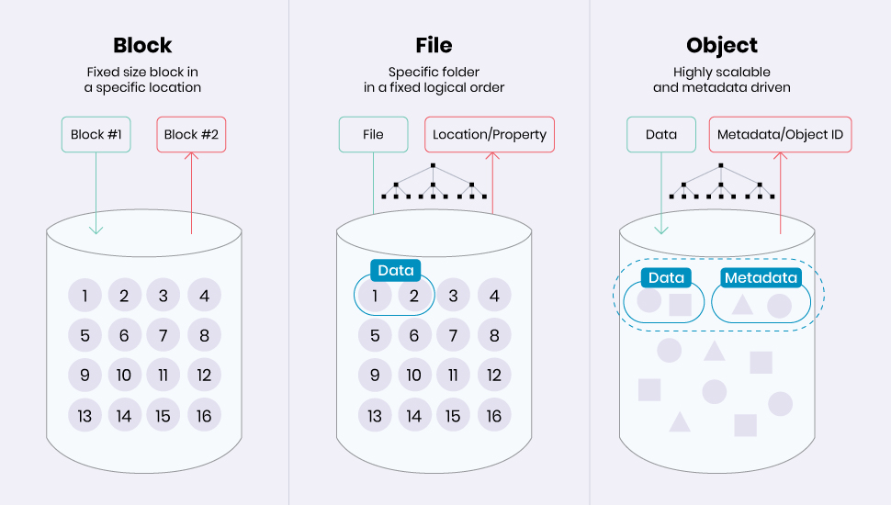
Cloud Storage: Data Management

Slide 80
Cloud Storage: Data Management
Data Management Strategies
Replication & Redundancy:
Geo-Replication: Copies data across multiple regions (e.g., Azure Geo-Redundant Storage).
RAID-like Redundancy: Combines disk arrays for fault tolerance.
Use Case: Ensures high availability during outages.Backup & Disaster

Slide 81
Cloud Storage: Data Management
Data Management Strategies
Backup & Disaster Recovery:
Automated Snapshots: Point-in-time backups (e.g., AWS EBS Snapshots).
Cold Storage: Long-term archival (e.g., AWS Glacier, Google Coldline).
RTO/RPO:
Recovery Time Objective (RTO): Time to restore operations.
Recovery Point Objective (RPO): Maximum data loss tolerance.

Slide 82
Cloud Storage: Data Management
Data Management Strategies
Security & Compliance:
Encryption:
At Rest: AES-256 encryption (e.g., AWS S3 server-side encryption).
In Transit: TLS/SSL protocols.
IAM Policies: Role-based access control (RBAC).
Compliance Frameworks: GDPR, HIPAA, SOC 2.

Slide 83
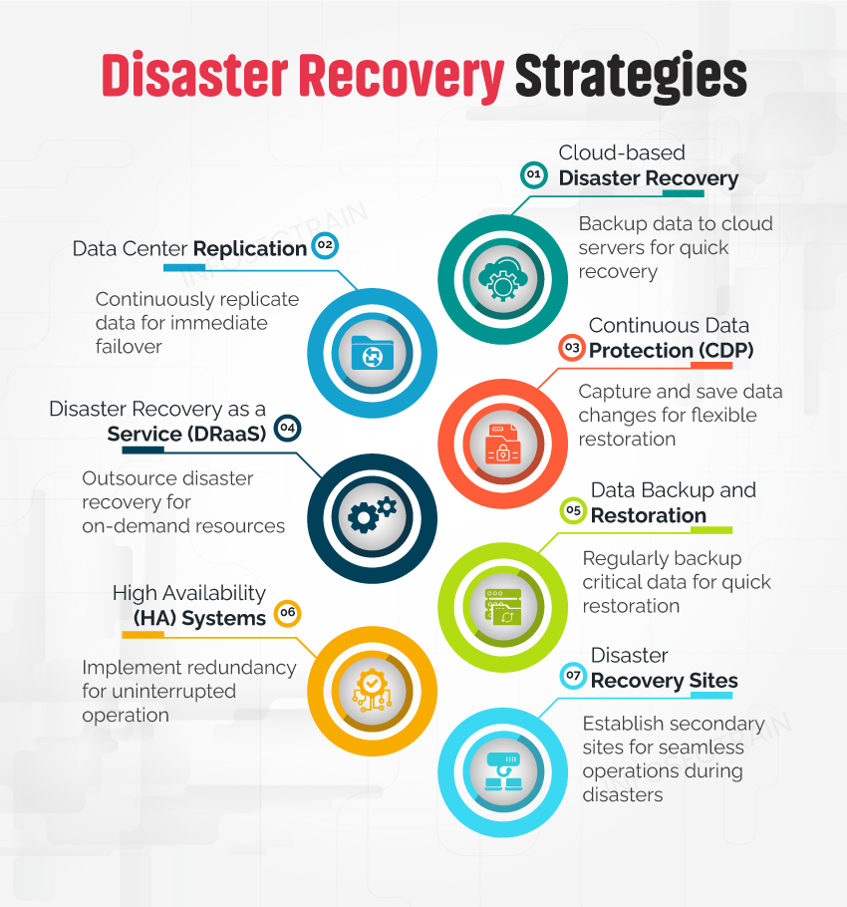
Data Management Strategies

Slide 84
Cloud Storage: Data Management
Metadata Management
Custom Tags: Attach metadata (e.g., creation date, author) for efficient search.
Example: AWS S3 object tagging for lifecycle policies.

Slide 85
Cloud Storage: Data Management
Data Governance
Data Sovereignty: Legal requirement to store data within geographic boundaries.
Audit Trails: Track access/modifications for compliance (e.g., AWS CloudTrail).
Lifecycle Management:
Phases: Creation → Active Use → Archival → Deletion.
Tools: AWS S3 Lifecycle Policies, Azure Blob Storage Tiering.

Slide 86
Provisioning Cloud Storage
Dynamic Allocation
On-Demand Scaling:
Automatically allocate storage based on workload (e.g., AWS Auto Scaling).
Thin Provisioning allocates storage only when needed to reduce waste.
Elasticity:
Burst Provisioning: Temporary scaling for peak demands (e.g., holiday sales).
Use Case: E-commerce platforms handling traffic spikes.

Slide 87
Provisioning Cloud Storage
Automation & APIs
Infrastructure-as-Code (IaC):
Define storage configurations using templates (e.g., AWS CloudFormation, Terraform).
Advantage: Consistency across environments.
RESTful APIs:
Programmatically manage storage (e.g., create buckets, upload objects).
APIs enable integration with DevOps pipelines.

Slide 88
Provisioning Cloud Storage
Storage Tiers & Cost Optimization
Performance Tiers:
Hot: Frequent access (e.g., active databases).
Cool: Infrequent access (e.g., backups older than 30 days).
Archive: Long-term retention (e.g., compliance data).
Cost Models:
Pay-as-You-Go: Ideal for unpredictable workloads.
Reserved Capacity: Discounted pricing for predictable enterprise needs.

Slide 89
Provisioning Cloud Storage
Monitoring & Management
Tools: AWS CloudWatch, Azure Monitor (track usage, latency, errors).
SLAs: Guarantees for uptime (e.g., 99.9%), throughput, and support response times.

Slide 90
Provisioning Cloud Storage
Enterprise Considerations
Hybrid Cloud:
Integrate on-premises storage with cloud (e.g., AWS Storage Gateway).
Use Case: Retailers using hybrid storage for inventory management.
Multi-Cloud Strategies:
Avoid vendor lock-in by distributing storage across AWS, Azure, GCP.

Slide 91
Challenges in Cloud Storage
Security Risks: Multi-tenancy vulnerabilities, misconfigured IAM policies.
Complexity: Managing data across hybrid/multi-cloud environments.
Cost Overruns: Unmonitored storage growth (solved via lifecycle policies).

Slide 92
Data-Intensive Technologies
Definition: Technologies designed to process, store, and analyze massive datasets (terabytes to petabytes) efficiently in cloud environments.
Use Cases:
Big data analytics (e.g., customer behavior analysis).
Real-time data processing (e.g., IoT sensor data).
Machine learning pipelines.

Slide 93
Core Technologies for Data-Intensive Workloads
Distributed Data Processing Frameworks
Apache Hadoop:
Components:
HDFS (Hadoop Distributed File System): Distributed storage for large datasets.
MapReduce: Batch processing model for parallel computation.
Cloud Integration:
AWS EMR (Elastic MapReduce), Google Dataproc.

Slide 94
Core Technologies for Data-Intensive Workloads
Distributed Data Processing Frameworks
Apache Spark:
Features: In-memory processing for faster data analytics. Supports both batch and stream processing.
Advantages: Faster than Hadoop for iterative algorithms(e.g., ML).
Enterprise Use: Real-time fraud detection in banking.

Slide 95
Core Technologies for Data-Intensive Workloads
Distributed Data Processing Frameworks
Apache Kafka:
Role: Distributed streaming platform for real-time data pipelines.
Use Case: Event-driven architectures (e.g., stock trading systems).

Slide 96
Core Technologies for Data-Intensive Workloads
Scalable Storage Systems
NoSQL Databases: Designed for scalability and flexibility in handling unstructured or semi-structured data.
Types:
Key-Value Stores: Redis, DynamoDB (for high-speed transactions).
Document Stores: MongoDB (flexible schema for JSON data).
Column-Family Stores: Cassandra (time-series data, IoT).
Cloud Services: AWS DynamoDB, Azure Cosmos DB.

Slide 97
Core Technologies for Data-Intensive Workloads
Scalable Storage Systems
Data Lakes:
Definition: Centralized repositories for raw, unstructured data (e.g., logs, videos).
Tools: AWS S3 + Athena, Azure Data Lake Storage.
Enterprise Focus: Governance and metadata tagging for compliance.

Slide 98
Core Technologies for Data-Intensive Workloads
Data Processing Models
Batch Processing:
Processes large volumes of data at once (e.g., monthly reports).
Examples: Hadoop MapReduce, AWS Glue.
Use Case: Monthly sales reports, ETL (Extract-Transform-Load) jobs.

Slide 99
Core Technologies for Data-Intensive Workloads
Data Processing Models
Stream Processing:
Handles real-time data streams for immediate analysis (e.g., IoT sensor data).
Tools: Apache Flink, AWS Kinesis.
Use Case: Real-time social media sentiment analysis.

Slide 100
Core Technologies for Data-Intensive Workloads
Data Processing Models
Hybrid Processing (Lambda Architecture):
Combines batch and stream processing for comprehensive analytics (e.g., Lambda architecture).

Slide 101
Cloud-Native Data-Intensive Architectures
Scalability & Elasticity
Auto-Scaling: Dynamically adjust resources (e.g., AWS Auto Scaling for Spark clusters).
Sharding: Horizontal partitioning of databases (e.g., MongoDB shards).
Fault Tolerance
Replication: Data copies across availability zones (e.g., HDFS replication factor).
Checkpointing: Save intermediate states in Spark to recover from failures.

Slide 102
Cloud-Native Data-Intensive Architectures
Performance Optimization
In-Memory Caching: Redis or Memcached to reduce latency.
Columnar Storage: Formats like Parquet for efficient querying (used in AWS Redshift).

Slide 103
Enterprise Considerations
Data Governance:
Metadata Management: Track data lineage and usage.
Compliance: GDPR, HIPAA, and data residency laws.
Cost Management:
Pay-per-Query Models: AWS Athena, Google BigQuery.
Reserved Instances: For predictable workloads (e.g., nightly batch jobs).

Slide 104
Enterprise Considerations
Hybrid & Multi-Cloud Strategies:
Example: Storing sensitive data on-premises while processing non-sensitive data in the cloud.

Slide 105
Challenges in Data-Intensive Cloud Computing
Data Silos: Integration of disparate data sources (solved via APIs and ETL tools).
Latency: Minimizing delays in real-time systems (optimized with edge computing).
Security:
Encryption of data in transit/rest.
Role-based access control (e.g., AWS IAM policies).

Slide 106
Introduction to Cloud File Systems
System that permanently stores data, to store that data in units called "files" on disks and other media Files are managed by the Operating System.
The part of the Operating System that deal with files is known as the "File System".
A file is a collection of disk blocks.

Slide 107
Introduction to Cloud File Systems
Definition: Distributed file systems designed for scalable, fault-tolerant storage across clusters of commodity hardware.
Key Use Cases: Big data processing, analytics, and enterprise cloud applications.
Examples: Google File System (GFS), Hadoop Distributed File System (HDFS).

Slide 108
Google File System (GFS)

Slide 109
Google File System (GFS)
Components:
Master Node: Manages metadata (file names, chunk locations, access control).
Chunk Servers: Store 64MB chunks of data; replicate chunks (default: 3 copies).
Clients: Interact with master for metadata, then read/write directly from chunk servers.

Slide 110
Google File System (GFS)
Key Features:
Fault Tolerance: Automatic chunk replication.
Relaxed Consistency: Append-heavy workloads
(e.g., "record append" for logs).
Optimized for Large Files: Efficient for streaming reads/writes.
GFS prioritizes high throughput over low latency, ideal for Google’s search indexing.

Slide 111
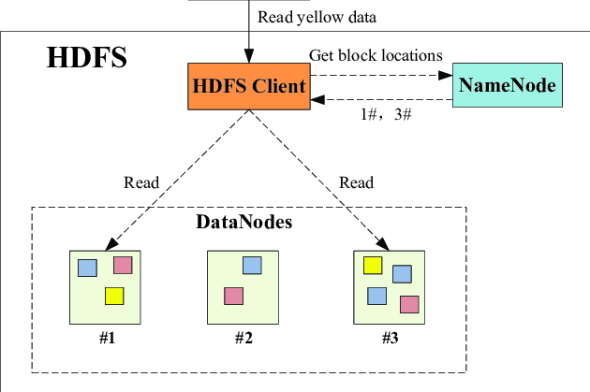
Hadoop Distributed File System (HDFS)

Slide 112
Hadoop Distributed File System (HDFS)
Components:
NameNode: Manages metadata (file system tree, block locations).
DataNodes: Store data blocks (default: 128MB); report health to NameNode.
Clients: Read/write via NameNode coordination.

Slide 113
Hadoop Distributed File System (HDFS)
Key Features:
Write-Once-Read-Many (WORM): Optimized for batch processing (e.g., MapReduce).
Replication: Configurable replication factor (default: 3).
Scalability: Horizontal scaling with commodity hardware.
HDFS is central to Hadoop’s ecosystem, enabling cost-effective big data analytics.

Slide 114
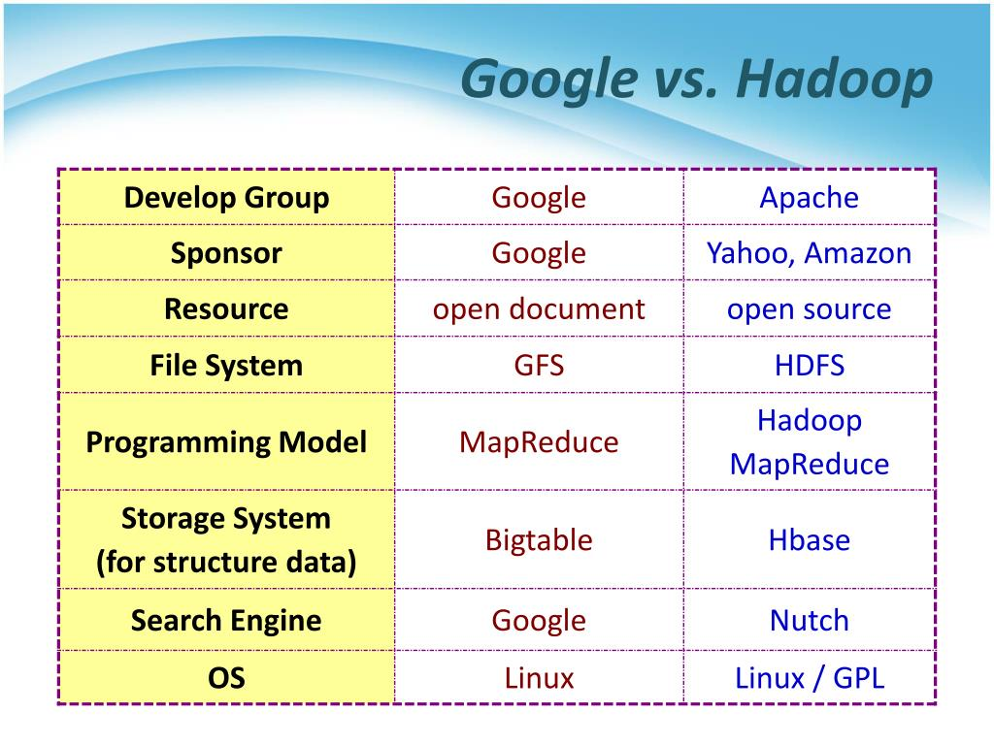
GFS vs. HDFS Comparison

Slide 115

Distributed Data Storage

Slide 116
Distributed Data Storage
A system where data is stored across multiple interconnected servers or nodes, rather than on a single machine.
Why Distribute Data?
Scalability: Handle massive amounts of data by adding more nodes. Traditional storage systems have limits.
Availability/Fault Tolerance: If one node fails, data remains accessible from other nodes. Redundancy is key.
Performance: Data can be stored closer to users, reducing latency and improving access speeds (especially for geographically dispersed users).
Cost-effectiveness: Can leverage commodity hardware rather than expensive, specialized storage systems.

Slide 117
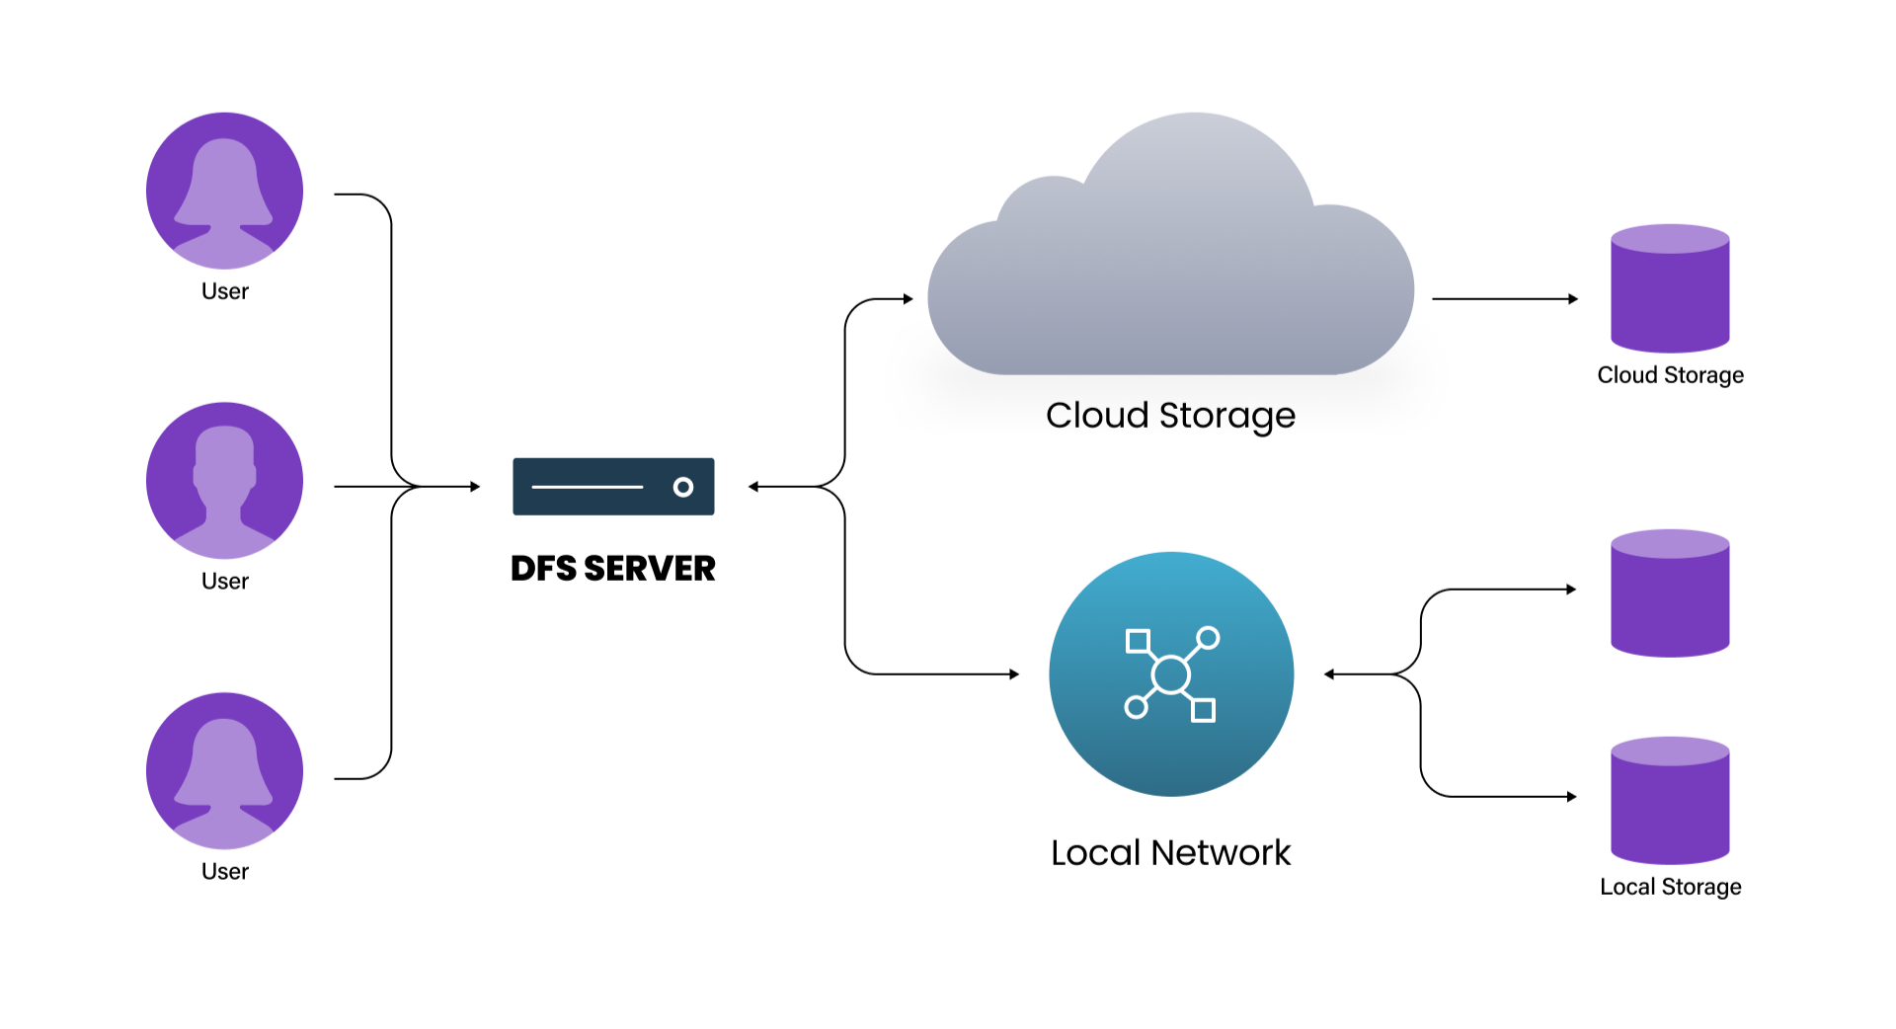
Types of Distributed Storage
File Systems: Data is organized as files and directories, distributed across multiple servers.
Examples: Hadoop Distributed File System (HDFS), GlusterFS.

Slide 118
Types of Distributed Storage
NoSQL Databases: Designed for unstructured or semi-structured data, often used for web applications and big data.
Examples: Cassandra, MongoDB.
Object Storage: Data is stored as objects with metadata, suitable for large amounts of unstructured data.
Examples: Amazon S3, OpenStack Swift.

Slide 119
Key Concepts in Distributed Storage
Data Partitioning (Sharding): Dividing data into smaller chunks (shards) and distributing them across nodes. Improves query performance.
Replication: Creating multiple copies of data and storing them on different nodes. Enhances availability and fault tolerance.
Consistency: Ensuring that all clients see the same view of the data, even with updates happening across multiple nodes. Different consistency models exist (e.g., strong consistency, eventual consistency).

Slide 120
Key Concepts in Distributed Storage
Fault Tolerance: The ability of the system to continue operating even if some nodes fail. Achieved through replication and other mechanisms.
Data Locality: Storing data closer to where it is accessed. Reduces latency and improves performance.

Slide 121
Challenges of Distributed Storage
Consistency Management: Maintaining data consistency across multiple nodes can be complex.
Fault Tolerance: Designing systems that can gracefully handle node failures.
Data Management: Managing large amounts of distributed data can be challenging.
Security: Ensuring the security of data stored across multiple locations.

Slide 122

THANK YOU !!
K.K.Wagh Institute of Engineering Education & Research, Nashik

